Slide 1
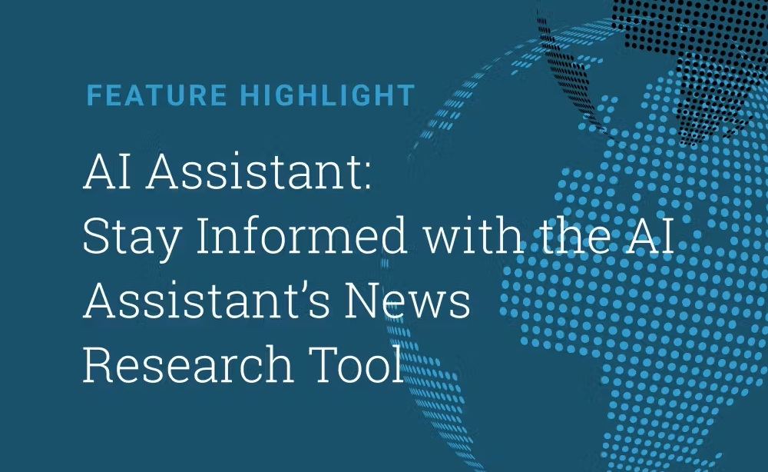
NEXTHIKE IT SOLUTIONS
News Research Tool

Slide 2
Project Summary
AI-powered equity research platform automating news analysis and sentiment detection.
Combines LLM summarization with structured AI agents for Buy / Sell / Hold decisions.
Reduces analyst effort by over 60% while improving consistency and speed.
Cloud-ready, cost-optimized, and suitable for enterprise-scale deployment.

Slide 3
Problem Statement
Large volumes of unstructured financial news must be analyzed daily.
Manual analysis introduces delay, bias, and inconsistency.
Need for an automated AI-driven equity research platform.

Slide 4
Project Objectives
Automate news ingestion and summarization.
Generate Buy / Sell / Hold recommendations.
Provide dashboards and exportable insights.

Slide 5
Key Capabilities
LLM-powered summarization.
LangGraph decision agents.
Sector dashboards and history tracking.
Secure, cloud-ready deployment.

Slide 6
Technology Stack
Frontend: Streamlit
Backend: Python 3.11
AI: OpenAI GPT-4o-mini + LangChain Core
Agents: LangGraph
DevOps: Docker, GitHub Actions

Slide 7
System Architecture (End-to-End Flow)
User (Web / Analyst)
↓
Streamlit UI (Presentation Layer)
↓
NewsAPI (Data Ingestion)
↓
LangChain Core (News Summarization)
↓
LangGraph Agent (Decision Engine)
↓
Dashboards & Database (Insights Storage)

Slide 8
Sector-wise Sentiment Analysis (Sample Dataset)

Slide 9
ROI & Cost-Saving Estimation
Manual research requires ~3–4 hours per company per week.
Automation reduces this effort by ~60–70%.
For 5 analysts: ~40–50 hours saved per week.
Estimated monthly savings: ₹1.6–2.0 lakhs with minimal AI cost.

Slide 10
Future Roadmap – Phase 2 & Phase 3
Phase 2: Real-time stock prices, technical indicators, alerts.
Phase 2: Vector database for long-term market memory.
Phase 3: Bull vs Bear multi-agent debate framework.
Phase 3: Enterprise features – RBAC, audit logs, APIs.

